Slide 1
Unit-2 C# Language Fundamentals

Slide 2
The Structure of a Simple C# Program
C# program consists of the following parts:
Namespace declaration
A class
Class methods
Class attributes
A Main method
Statements and Expressions
Comments

Slide 3
important points to remember about Csharp (C#)
Csharp (C#) is case sensitive.
All statements and expression must end with a semicolon (;).
The program execution starts at the Main method.
Program file name could be different from the class name.

Slide 4
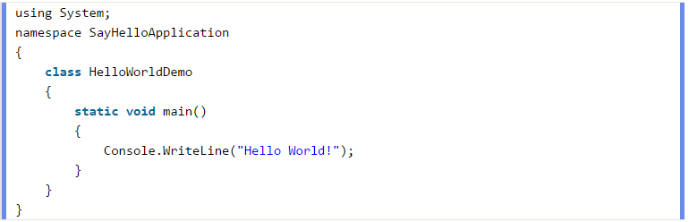

Slide 5
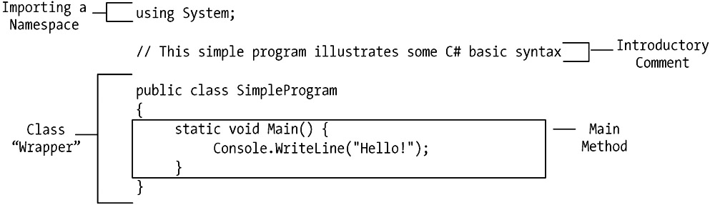

Slide 6
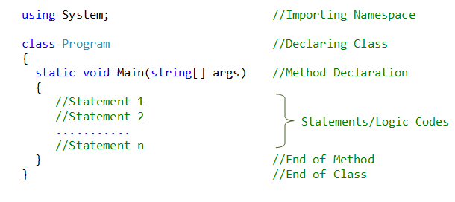

Slide 7
first line of the program
using System;
It is required in order for our program to compile and run properly.
by providing the compiler with knowledge of the types in the System namespace;
a namespace is a logical grouping of predefined C# programming elements.

Slide 8
First line in the program includes System namespace.
To include namespace the using keyword is used.
Namespace includes depends on program requirement.
System namespace contains fundamental classes and base classes that define commonly-used value and reference data types, events and event handlers, interfaces, attributes, and processing exceptions.

Slide 9
Comments
C# supports three different comment styles;
The C language style of block comment begins with a forward slash followed by an asterisk (/*) and ends with an asterisk followed by a forward slash (*/). Everything enclosed between these delimiters is treated as a comment and is therefore ignored by the compiler, no matter how many lines the comment spans.
/* This is a single line C-style comment. */
The C++ single line form of comment uses a double slash (//) to comment just to the end of a line, as shown here:
x = y + z; // text of comment continues through to the end of the line
a = b / c;
// Here is a BLOCK of sequential C++ style (single-line) comments.
// This serves as an alternative to using the C style
Note: - ?/td>
There is also a third type of C# comment that is used within XML document files.

Slide 10
second line in the program require unique namespace name.
A namespace consist of collection of classes.
Program has "SayHelloApplication" namespace that contains "HelloWorldDemo" class.
Third line, program declares class "HelloWorldDemo".

Slide 11
fourth line, program defines "Main" method, which is the entry point in C# programs.
The "Main" method has print statement which will execute when program run and print "Hello World".
WriteLine is a method of the Console class defined in the System namespace. This statement reason the message "Hello, World!" to be displayed on the screen.
CSharp program can be created either using Visual Studio .NET or using any text editor.

Slide 12
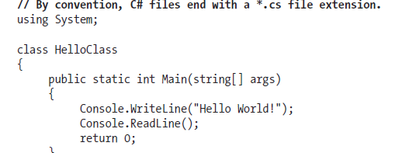
Variations on the Main() Method
Main() was defined to take a single parameter (an array of strings) and return an integer data type.
This is not the only possible form of Main().
It is permissible to construct your application’s entry point.

Slide 13
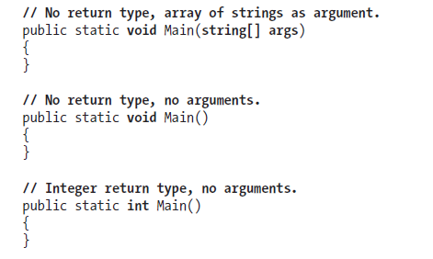

Slide 14
What is Command Line Argument in C#?
Pass parameter to a function as argument.
What about Main(string[] args) method?.
Do parameters can be passed to Main() method in C#?
Parameter(s) can be passed to a Main() method in C# and it is called command line argument.

Slide 15
Main() method is where program starts execution.
Main method doesn’t accept parameter from any method.
It accept parameter through command line.
It is an array type parameter that can accept n number of parameter in runtime.
In Main(string[] args) , args is a string type of array that can hold numerous parameter.

Slide 16
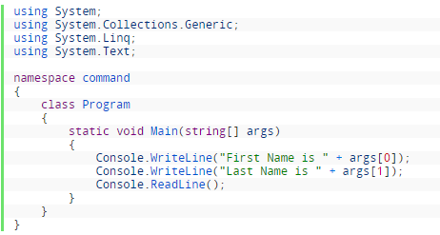
Example of Command Line Argument
To understand command line argument in C#:
Open Notepad and write the following code and save it with command.cs

Slide 17
2. Open visual studio command prompt and compile the code as follow: (i) Set current path, where your program is saved. (ii) Compile it with csc command.cs
3. Now execute the program using following command line argument: (a) command steven clark

Slide 18
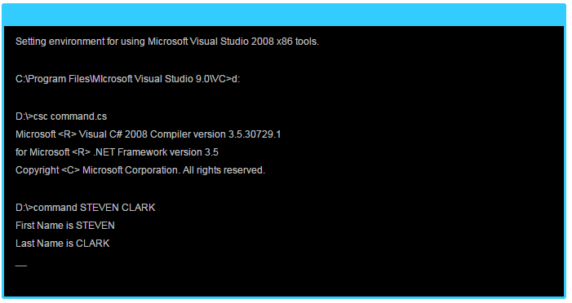

Slide 19
Specifying Command-Line Arguments with Visual Studio (various versions)
Right click your project in Solution Explorer and select Properties from the menu
Go to Configuration Properties -> Debugging
Set the Command Arguments in the property list.

Slide 20
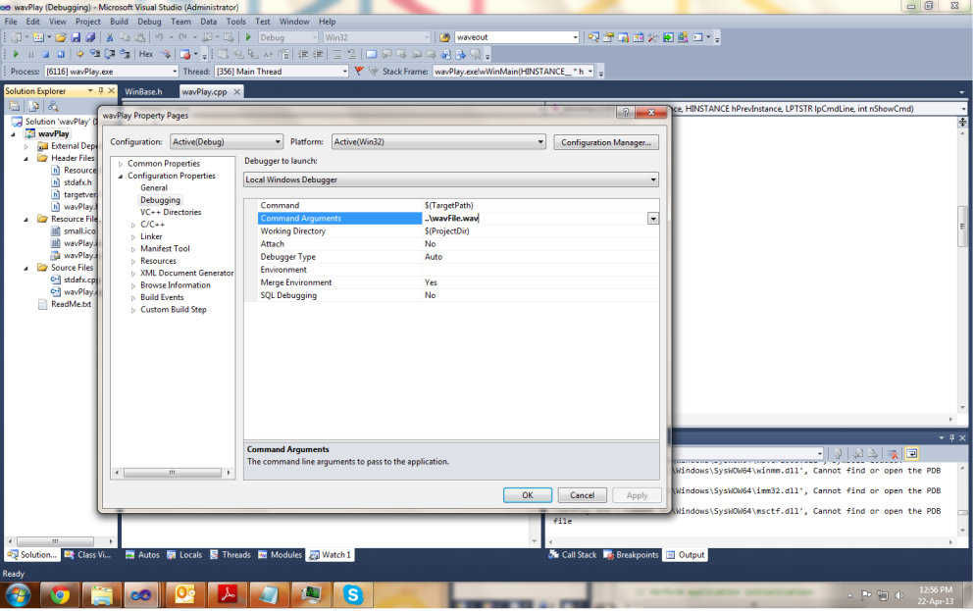

Slide 21
The system.Environment Class
System.Environment Class provides information about the current environment and platform.
The System.Environment Class uses to retrieve Environment variable settings, Version of the common language runtime, contents of the call stack etc. This class cannot be inherited.

Slide 22
The Environment class of the System namespace is useful for getting and setting various operating system related information.
You can use this class to retrieve information such as command-line arguments, exit codes, environment variable settings, contents of the call stack, last system boot in milliseconds (tick count), and version of the CLR.

Slide 23
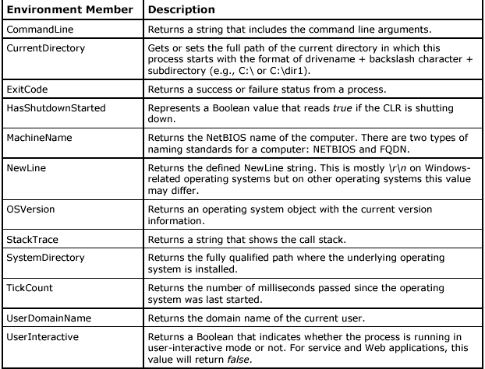
Members of the Environment class

Slide 24
case 3: SC.read(); SC.multiply(); break; case 4: SC.read(); SC.divide(); break; case 5: Environment.Exit(-1); break; default: Console.WriteLine(" Sorry !!! Wrong choice."); break; }

Slide 25
System.Console Class
Display things on the monitor's screen, the .NET Framework provides a class called as Console.
Console class represents the standard input, output, and error streams for console applications.
Console class cannot be inherited.
The Console class is defined in the System namespace.

Slide 26
System.Console provides the following Applications
Writing to the Console.
Writing With a New Line.
Reading a Value
Reading a Character
Reading With a New Line
Clearing the Console.

Slide 27
Writing to the Console
ability to display one or more values to the screen, the Console class is provide a method called Write.
To use the Write() method, inside of the parentheses, type the value you want to display.

Slide 28
Example
public class Exercise
{
static void Main()
{
System.Console.Write("The C# Programming");
}
}

Slide 29
Writing With a New Line
After displaying a value on the screen, the Write() method keeps the cursor on the same line.
The ability to move the cursor to the next line after displaying a value, the Console class is prepared with a method named WriteLine.

Slide 30
using System;
public class ConsoleTest {
public static void Main() {
Console.Write("Hello ");
Console.WriteLine("World!");
Console.Write("What is your name: ");
string name = Console.ReadLine();
Console.Write("Hello, ");
Console.Write(name);
Console.WriteLine("!");
}
}

Slide 31
output
Hello World!
What is your name: Ujwal
Hello, Ujwal!

Slide 32
Reading a Value
The Console class allows using the Write() or the WriteLine() methods to display values on the screen.
The Console also class provides the Read() method to get a value from the user.
Reads the next character from the standard input stream.

Slide 33
The syntax
VariableName = Console.Read();
When the user types something and press enter button, what the user had typed that word is assigned to the variable specified on the left side of the assignment operator.

Slide 34
Reading a Character
Each letter of the alphabet is represented on the keyboard by a key.
Other symbols, readable (such as #, @, or $) or not (such as Shift, Ctrl, or Enter) are also represented.
To get the letter or the action that those keys represent, the Console class is equipped with a method named ReadKey.
Syntax:
Console.ReadKey();

Slide 35
Reading With a New Line
The Console class also provides the ReadLine() method.
The WriteLine()method, after performing its assignment, the ReadLine() method sends the cursor to the next line. Otherwise, it plays the same role as the Read() function.
Syntax:
Console.Readline();

Slide 36
using System;
public class ExampleClass{
public static void Main() {
Console.WriteLine("Greetings! What is your name?");
Console.Write("My name is: ");
string name = Console.ReadLine();
Console.WriteLine("Nice to meet you, " + name);
Console.ReadKey();
}
}

Slide 37
Clearing the Console
If the console screen is filled with text you don't need anymore, you can empty it.
To allow you to clear the screen, the Console class is equipped with a method named clear.
syntax is:
public static void Clear();

Slide 38
Formatting Console Output
There is no direct "printf" duplication in C#.
Instead of this c # use some place holders to display the value in the console screen.
{0},{1},{2} etc are called place holders are used for string concatenation to display the output in the screen.

Slide 39
Instead of %d, %s, or %c format specifiers use {0},{1},{2} etc are used for string concatenation.
Example:
Console.WriteLine("args1: {0} args2: {1}", value1, value2);
Console.WriteLine("Hi {0} you are {1} years old.", nameInput, ageInteger);

Slide 40
string newString;
newString = String.Format("There are {0} cats in my {1} and no {2}", 2, "house", "dogs");
System.Console.WriteLine (newString);
There are 2 cats in my house and no dogs

Slide 41
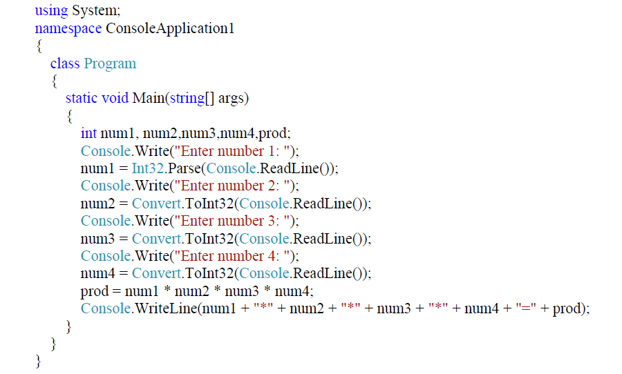

Slide 42
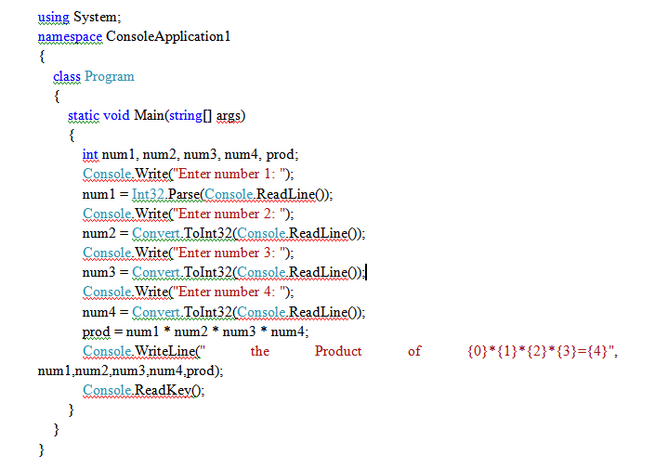

Slide 43
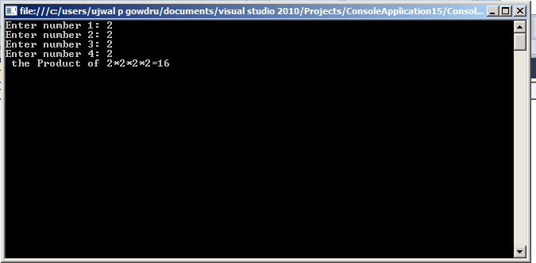

Slide 44
.NET String Formatting Flags
If you require more elaborate formatting, each placeholder can optionally contain various format characters.
Format character are in either uppercase or lowercase letter.

Slide 45
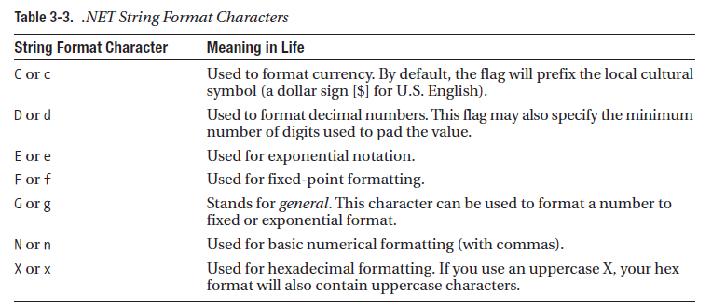
.NET String Formatting Flags

Slide 46
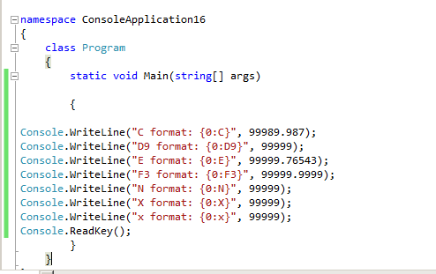

Slide 47
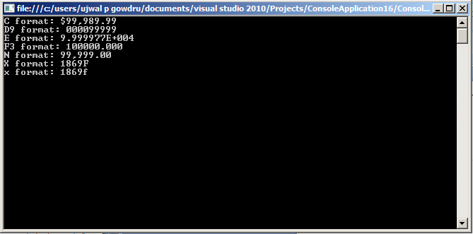

Slide 48
Defining Classes and Creating Objects
The mechanism that allows you to combine data and the function in a single unit is called a class.
A class is a construct that enables you to create your own custom types by grouping together variables of other types, methods and events.
A class is like a blueprint. It defines the data and behavior of a type.

Slide 49
Defining Classes and Creating Objects
A class definition starts with the keyword class followed by the class name; and the class body enclosed by a pair of curly braces.
Syntax:
Class Classname
{
Variable declaration;
Method declaration;
}
C++ semicolon after the closing brace. But c# no semicolon after the closing brace.

Slide 50
Where
class_name is a valid identifier for the class.
The body of the declaration can contain members, that can be either data or function declarations.

Slide 51
Adding variable
Data is encapsulated in a class by placing data fields inside the body of the class definition.
Class rectangle
{
Int length;
Int width;
}
Declaration is also in single line
Int length, width;

Slide 52
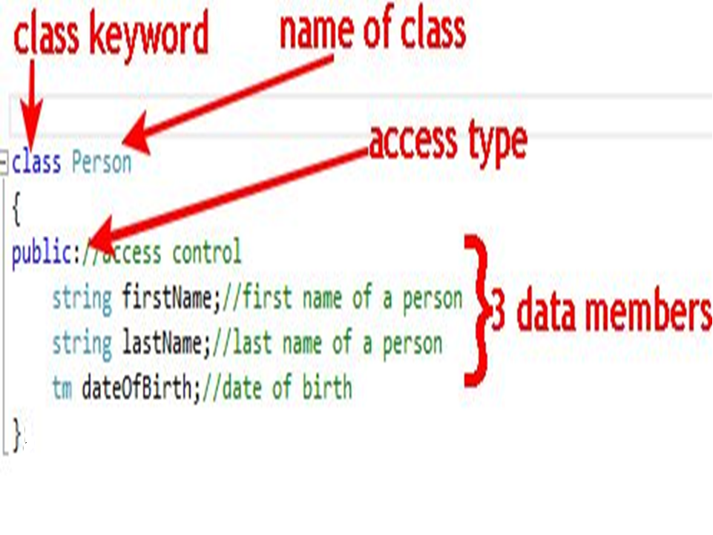

Slide 53
Adding methods
Class with any data fields and without methods that operate on that data has no life.
Methods are necessary for manipulating the data contained in the class.
Methods are declared inside the body of the class, usually after the declaration of instance variable.

Slide 54
syntax
Type method_name(parameter_list)
{
Method_body;
}
Example:
Class rectangle
{
Int length;
Int width;
Public void getdata(int x, int y)
{
Length=x;
Width=y;
}
}

Slide 55
Method has a return type void because it does not return any value.
Method pass two integer values which are then assigned to the instance variable length and width.

Slide 56
Class rectangle
{
Int length, width;
Public void getdata(int x, int y)
{
Length=x;
Width=y;
}
Public int rectarea()
{
Int area=length*width;
Return(area);
}
}

Slide 57
Creating objects
Once a class is defined, you can declare variables of that type. A class variable is called object or instance.
In Object Oriented terms, an Object is a software unit of variables (properties) and methods (functions). These objects are often used to model the real-world objects that you find in everyday life. An Object's method provide the only way to access the data.
Instances of classes are created by using the new operator.

Slide 58
Object Declaration
Once a class is defined, you can declare objects of that type.
The syntax for declaring a object is the same as that for declaring any other variable.
Below statements declare two objects of type circle:
Circle c1, c2;

Slide 59
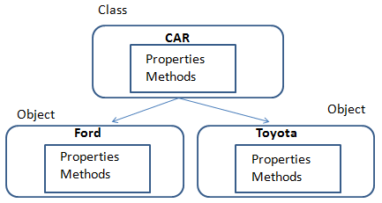

Slide 60
we have a class called "CAR".
All CAR have bodies, engines etc. and these could be the attributes (properties) of our CAR class.
CAR Class also have add some methods (functions) that would be common to all CAR like movement (forward and reverse), because all CAR can move .
The 'template' of a CAR does not change.
Each Object was built from the same set of template (Class) and therefore contains the same components.
All Objects share the same copy of the member functions (methods), but maintain a separate copy of the member data (Properties).
For example: A Ford car and a Toyota car are both Cars, so they can be classified as belonging to the Car class. All have same movement (methods) but different in models (properties).

Slide 61
class Car
{
public string steering;
public string brakes;
public string tyres;
public int forward()
{
// Write code here
}
public int backward()
{
// Write code here
}
}

Slide 62
class program
{
static void Main()
{
Calculator obj = new Calculator();
System.Console.WriteLine("2 + 3 = {0}", obj.Addem(2, 3));
}
}
class Calculator
{
public long Addem(int value1, int value2)
{
return value1 + value2;
}
}

Slide 63
Role of Constructor
Constructors are the special types of methods of a class which get executed when it's object is created.
Constructors are responsible for object initialization and memory allocation of its class.
There is always at least one constructor in every class.
If you don't write a constructor in class, C# compiler will automatically provide one constructor for that class, called default(parameter less) constructor.

Slide 64
class SampleA
{
public SampleA()
{
Console.WriteLine("Sample A Test Method");
}
}

Slide 65
Types of Constructors
Default Constructor
Parameterized Constructor
Copy Constructor
Static Constructor
Private Constructor

Slide 66
Default Constructor
A constructor without having any parameters called default constructor.
In this constructor every instance of the class will be initialized without any parameter values

Slide 67
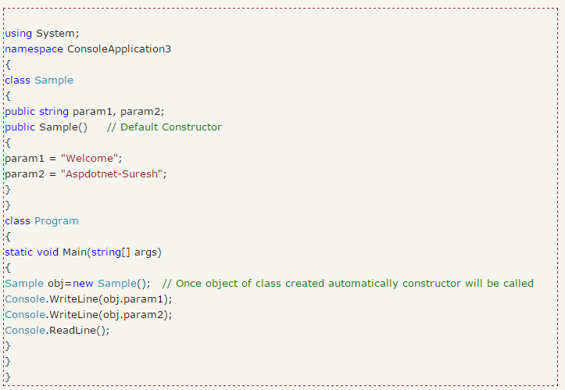

Slide 68
Parameterized Constructors
A constructor with at least one parameter is called as parameterized constructor.
In parameterized constructor we can initialize each instance of the class to different values

Slide 69
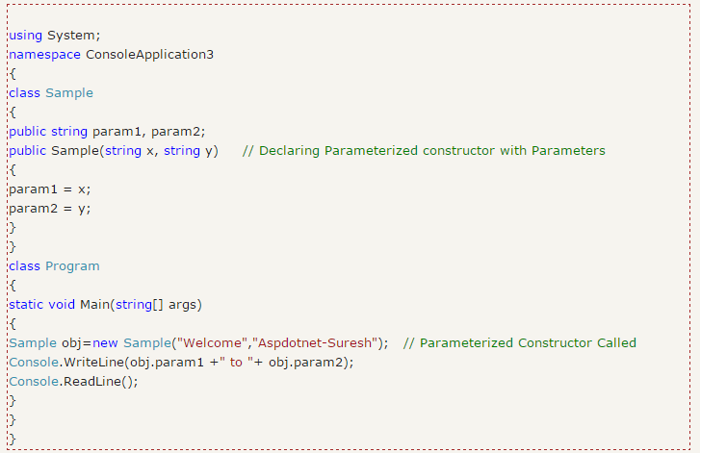

Slide 70
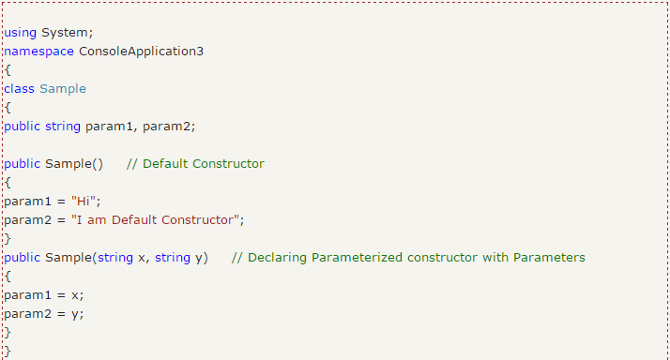
Constructor Overloading
In c# we can overload constructor by creating another constructor with same method name and different parameters.

Slide 71
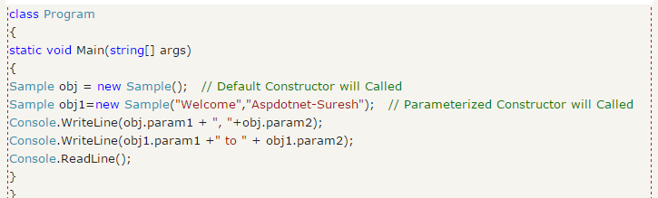

Slide 72
Copy Constructor
A parameterized constructor that contains a parameter of same class type is called as copy constructor.
Main purpose of copy constructor is to initialize new instance to the values of an existing instance.

Slide 73
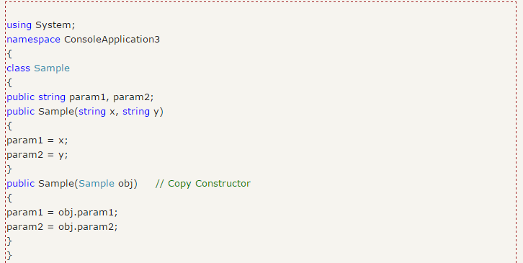

Slide 74
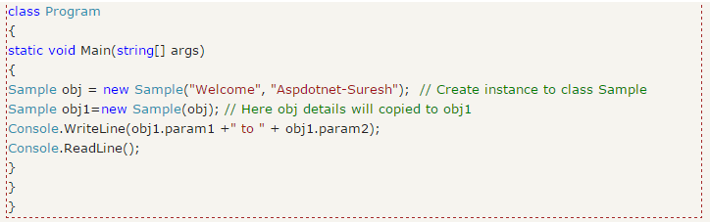

Slide 75
Iteration Constructs [Iteration statements or Loop Controls in C#]
All programming languages provide behavior to repeat blocks of code until a terminating condition has been met.
Perform operations a set number of times until you tell it to stop, with a true or false value.
Iteration statements enable the user to perform the same set of statements repeatedly until a specific condition is met.
Iteration statements also known as looping statements.

Slide 76
C# provides the following four iteration constructs
for loop
foreach/in loop
while loop
do/while loop

Slide 77
for Loop
It used if you know the start point and end point.
run a statement or a block of statements repeatedly until a specified expression evaluates to false.
for loop includes initialization and condition modification.
for loop also repeatedly executes a block of statement until specified condition get false.

Slide 78
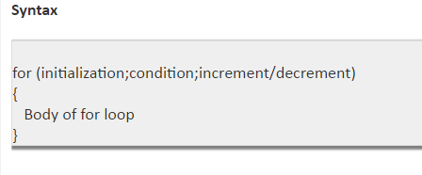

Slide 79
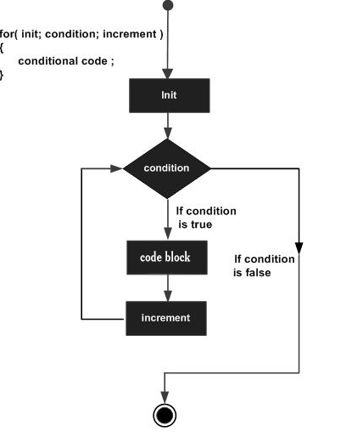

Slide 80
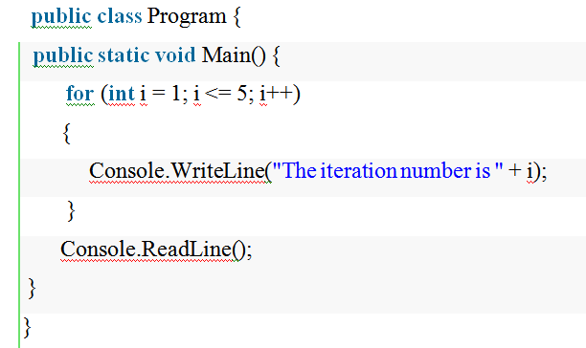

Slide 81


Slide 82
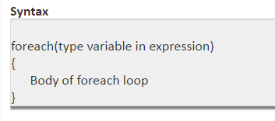
foreach Loop
The foreach statement repeats a group of embedded statements for each element in an array or an object collection.
foreach each loop is used to iterate the elements present in arrays.

Slide 83
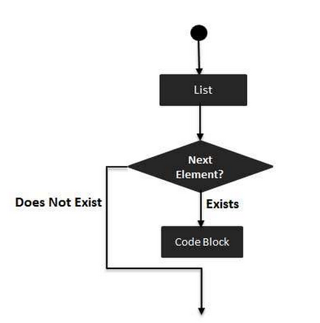

Slide 84
using System;
namespace Iteration
{
class foreachloop
{
static void Main()
{
int[] arr = { 10, 20, 30, 40, 50 };
foreach(int i in arr)
{
Console.WriteLine(" " + i);
}
Console.ReadLine();
}
}
}

Slide 85
using System;
class ForEachLoop
{
public static void Main()
{
string[] names = {"Cheryl", "Joe", "Matt", "Robert"};
foreach (string person in names)
{
Console.WriteLine("{0} ", person);
}
}
}

Slide 86
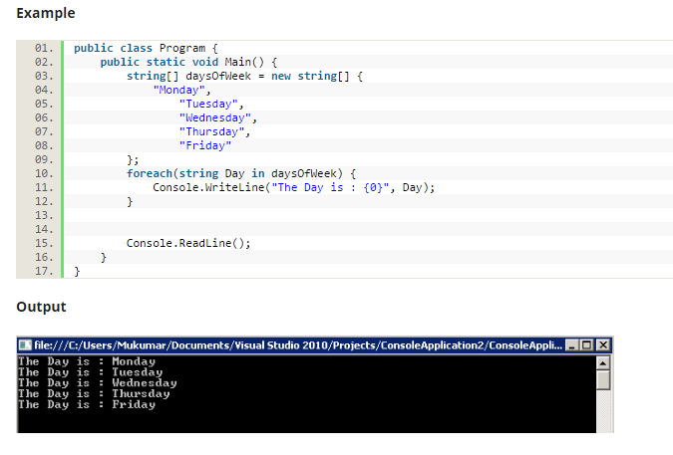

Slide 87
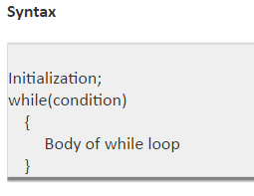
while Loop
It is a simple loop. It executes till the code block while the condition is true.
If the condition is going to be false, the program will exit from the loop.
While loop repeatedly executes a block of statements until specified condition get false.
While loop checks the condition before entering the first iteration.

Slide 88
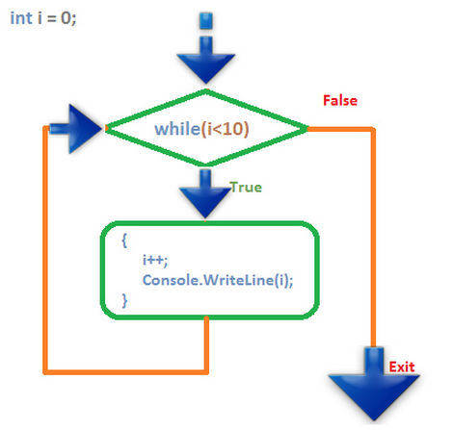

Slide 89
public class Program
{
public static void Main()
{
int num = 1;
while (num <= 10) {
Console.WriteLine("The number is {0}", num); num++;
}
Console.ReadLine();
}
}

Slide 90
Do-While Statement
The do while loop is same as while loop except that it will be running at least one time if condition is matched or not.
It is because it does not check the condition first time. So, it is guaranteed to execute the code of program at least one iteration.
Do execute a statement or block of statements until a specified expression evaluates to FALSE.

Slide 91
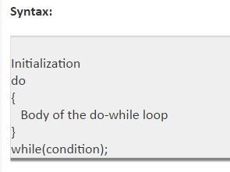

Slide 92
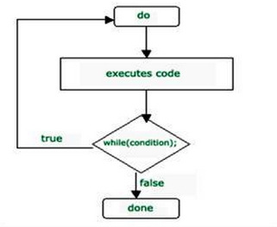

Slide 93
public class Program {
public static void Main() {
int num = 1;
do {
Console.WriteLine("The number is {0}", num);
num++;
} while (num <= 10);
Console.ReadLine();
}
}

Slide 94
Decision Constructs and the Relational/Equality Operators
C# defines two simple constructs to alter the flow of your program:
The if/else statement
The switch statement

Slide 95
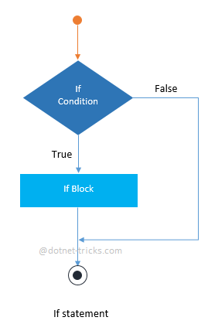
If statement
An if statement consists of a boolean expression which is evaluated to a boolean value.
If the value is true then if block is executed otherwise next statement(s) would be executed.

Slide 96
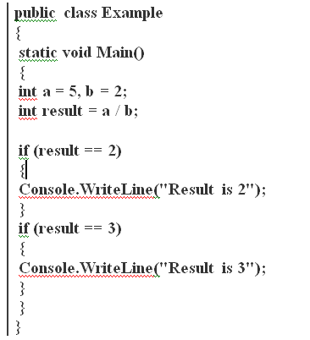

Slide 97
Also do nesting of if statement means an if statement inside another if that is called nested if statement.

Slide 98
If-Else statement
An if-else statement consists of two statements:
if statement
else statement.
When the expression in an if-statement is evaluated to true then if block is executed otherwise the else block would be executed.

Slide 99
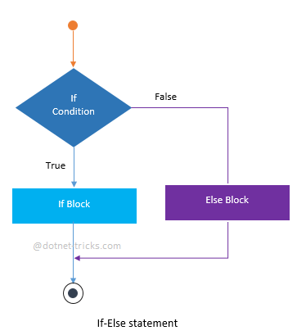

Slide 100
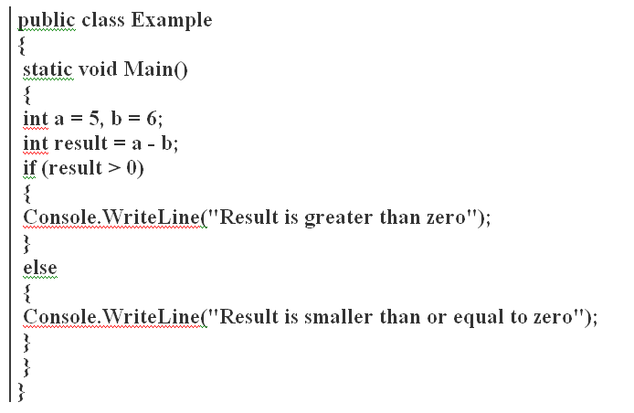

Slide 101
If-Else-If statement or ladder
The If-Else-If ladder is a set of statements that is used to test a series of conditions.
If the first if statement meet the result then code within the if block executes. If not, control passes to the else statement, which contains a second "if" statement.
If second one meet the result then code within the if block executes. This continues as a series of else if statements.
A default else code block may execute when no condition has been evaluated to true.

Slide 102
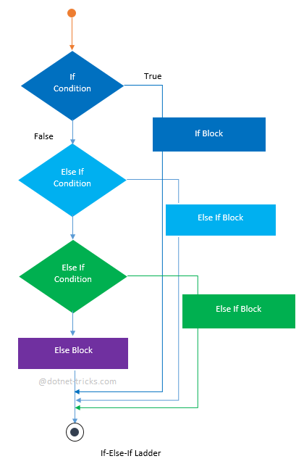

Slide 103
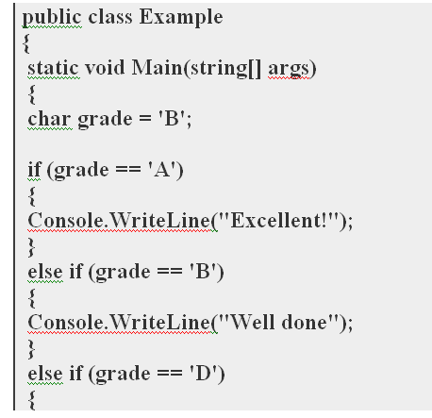

Slide 104
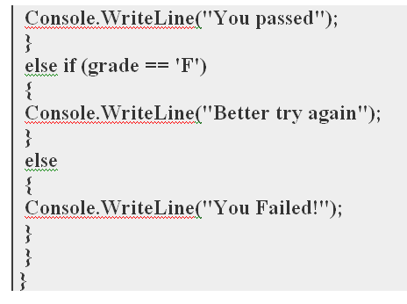

Slide 105
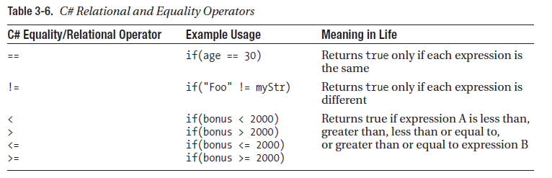

Slide 106
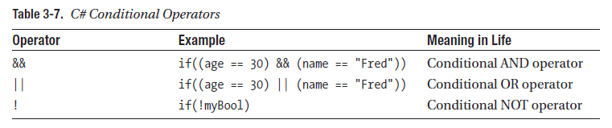

Slide 107
Switch statement
Switch statement acts as a substitute for long If-Else-If ladder that is used to test a series of conditions.
A switch statement contains one or more case labels which are tested against the switch expression.

Slide 108
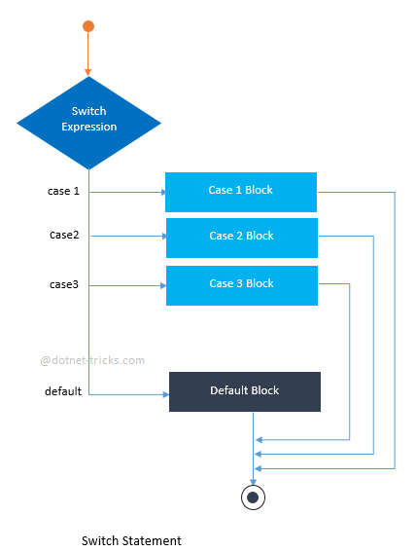

Slide 109
When one case matches the value with the result of switch expression, the control continues executing the code from that label.
When no case label contains a matching value, control is transferred to the default section, if it exists.
If there is no default section, no action is taken and control is transferred outside the switch statement.

Slide 110
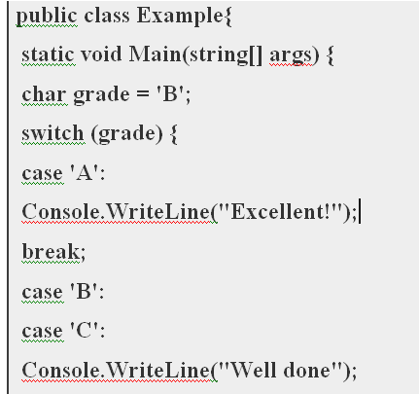

Slide 111
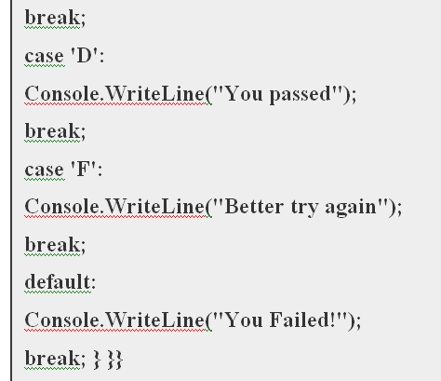

Slide 112
Understanding Value Types and Reference Types
Consider the example:
namespace CSharpTutorials
{
class Program
{
static void Main(string[] args)
{
string message = "Hello World!!";
Console.WriteLine(message);
}
}
}

Slide 113
A variable must be declared with the data type because C# is a strongly-typed language.
Example: string message = "Hello World!!";
string is a data type.
message is a variable.
"Hello World!!" is a string value assigned to a variable - message.
The data type tells a C# compiler what kind of value a variable can hold.
C# includes many in-built data types for different kinds of data, e.g., String, number, float, decimal, etc.

Slide 114
class Program
{
static void Main(string[] args)
{
string stringVar = "Hello World!!";
int intVar = 100;
float floatVar = 10.2f;
char charVar = 'A';
bool boolVar = true;
}
}

Slide 115
Each data types includes specific range of values.
For example, a variable of int data type can have any value between -2,147,483,648 to 2,147,483,647.
The same way, bool data type can have only two value - true or false.

Slide 116
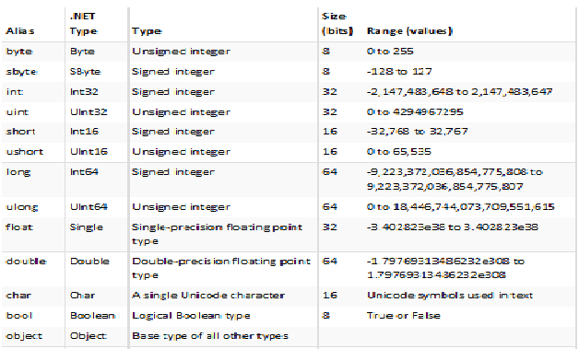

Slide 117
Compiler will give an error if value goes out of data type's permitted range.
For example, int data type's range is -2,147,483,648 to 2,147,483,647.
Example: Compile time error
// compile time error: Cannot implicitly convert type 'long' to 'int'.
int i = 21474836470;

Slide 118
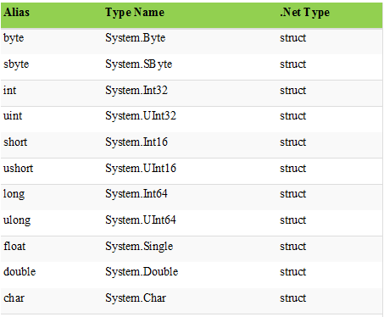
system data types ( c# alias)

Slide 119
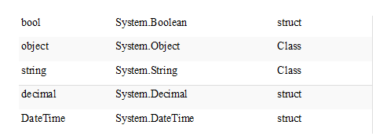

Slide 120
Value Types and Reference Types
Data types are classified as:
value type.
reference type,
Data Types is classified depending on whether a variable of a particular type stores its own data or a pointer to the data in the memory.

Slide 121
Value Type
A data type is a value type if it holds a data value within its own memory space.
It means variables of these data types directly contain their values.
All the value types derive from System.ValueType,
which in-turn, derives from System.Object.

Slide 122
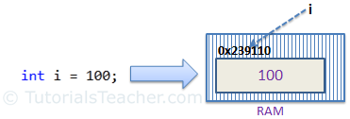
Consider integer variable:
int i = 100;
The system stores 100 in the memory space allocated for the variable 'i'.
The below image illustrates how 100 is stored at some hypothetical location in the memory (0x239110) for 'i':

Slide 123
The following data types are all of value type
bool
byte
char
decimal
double
enum
float
int
long
sbyte
short
struct
uint
ulong
ushort

Slide 124
Passing by Value
100 200 100
100 200 100
When you pass a value type variable from one method to another method.
the system creates a separate copy of a variable in another method.
so that if value got changed in the one method won't affect on the variable in another method.
variable i in Main() method remains unchanged even after we pass it to the ChangeValue() method and change it's value there.
static void ChangeValue(int x)
{
x = 200;
Console.WriteLine(x);
}
static void Main(string[] args)
{
int i = 100;
Console.WriteLine(i);
ChangeValue(i);
Console.WriteLine(i);
}
Result:
100
200
100

Slide 125
Reference type
Unlike value types, a reference type doesn't store its value directly.
It stores the address where the value is being stored.
In other words, a reference type contains a pointer to another memory location that holds the data.
For example, consider following string variable:
string s = "Hello World!!";

Slide 126
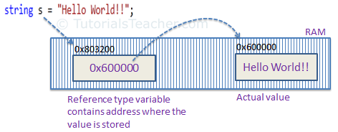

Slide 127
The system selects a random location in memory (0x803200) for the variable 's'.
The value of a variable s is 0x600000 which is the memory address of the actual data value.
Thus, reference type stores the address of the location where the actual value is stored instead of value itself.

Slide 128
The following data types are of reference type
String
All arrays, even if their elements are value types
Class
Delegates

Slide 129
Passing by Reference
When you pass a reference type variable from one method to another, it doesn't create a new copy; instead, it passes the address of the variable.
If we now change the value of the variable in a method, it will also be reflected in the calling method.

Slide 130
Passing by Reference
static void ChangeReferenceType(Student std2)
{
std2.StudentName = "Steve";
}
static void Main(string[] args)
{
Student std1 = new Student();
std1.StudentName = "Bill";
ChangeReferenceType(std1);
Console.WriteLine(std1.StudentName);
}
OUTPUT : Steve

Slide 131
Above Example
Student is an object, when we send the Student object std1 to the ChangeReferenceType() method, what is actually sent is the memory address of std1. Thus, when the ChangeReferenceType() method changes StudentName, it is actually changing StudentName of std1, because std1 and std2 are both pointing to the same address in memory.

Slide 132
understanding Boxing and UnBoxing operations
C# Type System contains:
Value Types,
Reference Types,
C# allows us to convert a Value Type to a Reference Type, and back again to Value Types.
The operation of Converting a Value Type to a Reference Type is called Boxing and the reverse operation is called UnBoxing.

Slide 133
Boxing
Implicit conversion of a value type (int, char etc.) to a reference type (object), is known as Boxing.
In Boxing process, a value type is being allocated on the heap rather than the stack.
Boxing is used to store value types in the garbage-collected heap.

Slide 134
int Val = 1;
Object Obj = Val; //Boxing
The first line we created a Value Type Val and assigned a value to Val.
The second line, we created an instance of Object Obj and assign the value of Val to Obj.
From the above operation (Object Obj = 1) we saw converting a value of a Value Type into a value of a corresponding Reference Type.
These types of operation are called Boxing.

Slide 135
The following declaration of a value-type variable:
int i = 123;
The following statement implicitly applies the boxing operation on the variable i:
// Boxing copies the value of i into object o.
object o = i;
The result of this statement is creating an object reference o, on the stack, that references a value of the type int, on the heap.

Slide 136


Slide 137
class TestBoxing
{
static void Main()
{
int i = 123;
// Boxing copies the value of i into object o.
object o = i;
// Change the value of i.
i = 456;
// The change in i does not effect the value stored in o.
System.Console.WriteLine("The value-type value = {0}", i);
System.Console.WriteLine("The object-type value = {0}", o);
}
}
/* Output:
The value-type value = 456
The object-type value = 123
*/

Slide 138
UnBoxing
Explicit conversion of same reference type (which is being created by boxing process); back to a value type is known as UnBoxing.
In UnBoxing process, boxed value type is unboxed from the heap and assigned to a value type which is being allocated on the stack.
UnBoxing is the opposite of boxing.
In it values are again shifted from the heap to the stack.

Slide 139
int Val = 1;
Object Obj = Val; //Boxing
int i = (int)Obj; //Unboxing
The first two line shows how to Box a Value Type.
The third line (int i = (int) Obj) shows extracts the Value Type from the Object.
That is converting a value of a Reference Type into a value of a Value Type. This operation is called UnBoxing.

Slide 140

int i = 123; // a value type object o = i; // boxing int j = (int)o; // unboxing

Slide 141
Example of Boxing and UnBoxing
// int (value type) is created on the Stack
int stackVar = 12;
// Boxing = int is created on the Heap (reference type)
object boxedVar = stackVar;
// Unboxing = boxed int is unboxed from the heap and assigned to an int stack variable
int unBoxed = (int)boxedVar;

Slide 142


Slide 143
Establishing Member Visibility (Access Specifiers)
What is Access Specifiers in C#?
Also called as Access Modifiers.
It describes as the scope of accessibility of an Object and its members.
Access modifiers and specifiers are keywords to specify the accessibility of a type and its members.
We can control the scope of the member object of a class using access specifiers.

Slide 144
List of Access Specifiers
Public Access Specifiers
Private Access Specifiers
Protected Access Specifiers
Internal Access Specifiers
Protected Internal Access Specifiers.

Slide 145
What is public access specifier?
The class member, that is defined as public can be accessed by other class member that is initialized outside the class.
A public member can be accessed from anywhere even outside the namespace.
public: has no limits, any members or types defined as public can be accessed within the class, assembly even outside the assembly, class.

Slide 146
using System;
using System.Collections.Generic;
using System.Linq;
using System.Text;
namespace Public_Access_Specifiers
{
class access
{
// String Variable declared as public
public string name;
// Public method
public void print()
{
Console.WriteLine("\nMy name is " + name);
}
}

Slide 147
class Program
{
static void Main(string[] args)
{
access ac = new access();
Console.Write("Enter your name:\t");
// Accepting value in public variable that is outside the class
ac.name = Console.ReadLine();
ac.print();
Console.ReadLine();
}
}
}

Slide 148
Private Access Specifiers
The private access specifiers restrict the member variable or function to be called outside from the parent class.
A private function or variable cannot be called outside from the same class.
It hides its member variable and method from other class and methods.
However, you can store or retrieve value from private access modifiers using get set property.

Slide 149
using System;
using System.Collections.Generic;
using System.Linq;
using System.Text;
namespace Private_Access_Specifiers
{
class access
{
// String Variable declared as private
private string name;
public void print() // public method
{
Console.WriteLine("\nMy name is " + name);
}
}

Slide 150
class Program
{
static void Main(string[] args)
{
access ac = new access();
Console.Write("Enter your name:\t");
// raise error because of its protection level
ac.name = Console.ReadLine();
ac.print();
Console.ReadLine();
}
}
}

Slide 151


Slide 152
Protected Access Specifiers
The protected access specifier hides its member variables and functions from other classes and objects.
This type of variable or function can only be accessed in child class.
It becomes very important while implementing inheritance.

Slide 153
using System;
using System.Collections.Generic;
using System.Linq;
using System.Text;
namespace Protected_Specifier
{
class access
{
// String Variable declared as protected
protected string name;
public void print()
{
Console.WriteLine("\nMy name is " + name);
}
}
class Program
{
static void Main(string[] args)
{
access ac = new access();
Console.Write("Enter your name:\t");
// raise error because of its protection level
ac.name = Console.ReadLine();
ac.print();
Console.ReadLine();
}
}
}

Slide 154


Slide 155
Internal Access Specifiers
The internal access specifier hides its member variables and methods from other classes and objects, that is resides in other namespace.
The variable or classes that are declared with internal can be access by any member within application.
It is the default access specifiers for a class in C# programming.

Slide 156
using System;
using System.Collections.Generic;
using System.Linq;
using System.Text;
namespace Internal_Access_Specifier
{
class access
{
// String Variable declared as internal
internal string name;
public void print()
{
Console.WriteLine("\nMy name is " + name);
}
}
class Program
{
static void Main(string[] args)
{
access ac = new access();
Console.Write("Enter your name:\t");
// Accepting value in internal variable
ac.name = Console.ReadLine();
ac.print();
Console.ReadLine();
}
}
}

Slide 157
Establishing type visibility
Types (classes, interfaces, structures, enumerations, and delegates) can also take accessibility modifiers, but are limited to public or internal.
When you create a public type, you ensure that the type can be accessed from other types in the current assembly as well as external assemblies.
// This type can be used by any assembly.
public class MyClass{}
An internal type, on the other hand, can be used only by the assembly in which it is defined.
// These classes can only be used by the defining assembly.
internal class MyHelperClass{}
class FinalHelperClass{} // Types are internal by default in C#.

Slide 158
Default Values of Class Member Variables
The member variables of class types are automatically set to an appropriate default value.
This value will differ based on the exact data type.
the rules are simple:
bool types are set to false.
Numeric data is set to 0
string types are set to null.
char types are set to '\0'.
Reference types are set to null

Slide 159
Defining Constant Data
Const is a keyword that indicates a constant.
It describes an entity that cannot be changed at program runtime.
The constants refer to fixed values that the program may not alter during its execution.
Constant values are also called literals.
Constants can be of any of the basic data types like an integer constant, a floating constant, a character constant, or a string literal.

Slide 160
class Calendar2
{
const int months = 12, weeks = 52, days = 365;
}
=========================
class Calendar3
{
const int months = 12;
const int weeks = 52;
const int days = 365;
const double daysPerWeek = (double) days / (double) weeks;
const double daysPerMonth = (double) days / (double) months;
}

Slide 161
Using System
class clsPiValue
{
public const double Pi = 3.14;
}
class Program
{
static void Main(string[] args)
{
Console.WriteLine("PI Value is : " + clsPiValue.Pi);
}
}

Slide 162
Defining Read-Only Fields
Readonly prevents fields from being changed.
Readonly fields can be initialized at runtime, unlike const values.
Attempts to change them later are disallowed.

Slide 163


Slide 164


Slide 165
Public static readonly
A Static Readonly type variable's value can be assigned at runtime or assigned at compile time and changed at runtime.
This variable's value can only be changed in the static constructor. And cannot be changed further.
It can change only once at runtime.

Slide 166


Slide 167
The Complete Set of C# Operators
An operator is a symbol that tells the compiler to perform specific mathematical or logical manipulations.
C# has rich set of built-in operators and provides the following type of operators:
Arithmetic Operators
Relational Operators
Logical Operators
Bitwise Operators
Assignment Operators
Misc Operators

Slide 168

Arithmetic Operators Arithmetic operator performs basic calculation as add, subtraction, multiplication, division, and modulus

Slide 169

Relational Operators

Slide 170

Logical Operators

Slide 171

Bitwise Operators

Slide 172


Slide 173


Slide 174

Assignment Operators

Slide 175


Slide 176

Miscellaneous Operators

Slide 177
Defining Structures in C#
Structure is the value type data type that can contain variables, methods, properties, events and so on.
It simplifies the program and enhances performance of code in C# programming.
A structure can be defined using the struct keyword.

Slide 178
Defining a Structure
Must use the struct statement.
The struct statement defines a new data type, with more than one member for your program.
struct Books
{
public string title;
public string author;
public string subject;
public int book_id;
};

Slide 179
Objects of a struct can be created
The objects of a struct can be created or struct can be initialized by with or without using the new keyword.
struct MyStruct
{
public int x;
public int y;
}
// Objects of a struct can be created
MyStruct ms = new MyStruct();
OR
MyStruct ms;

Slide 180
Structs & Fields
A struct in C# can contain fields.
These fields can be declared as private, public, internal.
Remember that inside a struct, we can only declare a field.
We can't initialize a field inside a struct.
However we can use constructor to initialize the structure fields.

Slide 181
struct MyStruct
{
int x = 20; // Error its not possible to initialize
int y = 20; // Error its not possible to initialize
}

Slide 182
using System;
struct MyStruct
{
public int x;
public int y;
}
class MyClient {
public static void Main() {
MyStruct ms = new MyStruct();
ms.x = 10;
ms.y = 20;
int sum = ms.x + ms.y;
Console.WriteLine("The sum is {0}", sum);
}
}

Slide 183
struct can contain static fields, which can be initialized inside the struct
using System;
struct MyStruct {
public static int x = 25;
public static int y = 50;
}
class MyClient {
public static void Main() {
int sum = MyStruct.x + MyStruct.y;
Console.WriteLine("The sum is {0}", sum);
}
}
static fields can't be accessed by an instance of a struct. We can access them only by using the struct names.

Slide 184
Struct & Methods
A C# struct can also contain methods.
The methods can be either static or non-static.
But static methods can access only other static members and they can't invoke by using an object of the structure.
They can invoke only by using the struct name.

Slide 185
using System;
struct MyStruct {
static int x = 25;
static int y = 50;
public void SetXY(int i, int j) {
x = i;
y = j;
}
public static void ShowSum() {
int sum = x + y;
Console.WriteLine("The sum is {0}", sum);
}
}
class MyClient {
public static void Main() {
MyStruct ms = new MyStruct();
ms.SetXY(100, 200);
MyStruct.ShowSum();
}
}

